Slide 1
Image scraping and classification project
Submitted by:
ABHISHEK KUMAR
BATCH -29
SME--- SWATANK MISHRA SIR

Slide 2
Business problem framing
The idea behind this project is to build a deep learning based image classification model on images that will be scraped from the E-commerce website. This is done to make the model more and more robust. This task is divided into two phases. First, Data collection and Second is Model Building.
Data Collection Phase: in this section, we need to scrape images from e-commerce website named ‘Amazon.in’. The clothing categories used for scrapping will be-
1. Sarees (women)
2. Trousers (men)
3. Jeans (men)

Slide 3
Dataset
The dataset used in the given problem is comprised of the images that I have scraped from ‘Amazon.in’ website.
I have scraped total 1500 images using Selenium Automated Software.
Out of 1500 images, I segregated 1350 images as training dataset and rest 150 images as test dataset.

Slide 4
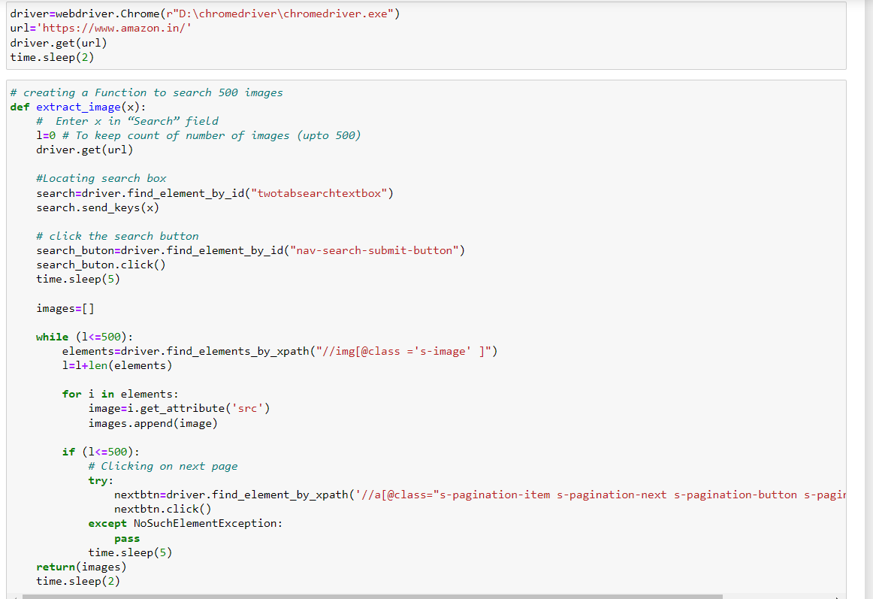
Data collection
The problem statement says to scrape at least 200 images for each clothing category. But for the better performance of the model I scraped more data to train the model.
The clothing categories are as follows:
1. Sarees (women)
2. Trousers (men)
3. Jeans (men)
I collected total 500 images for each of the above category.

Slide 5
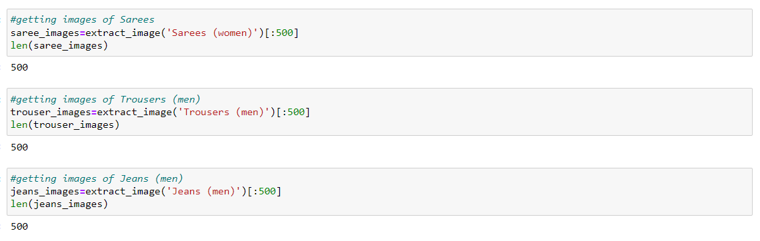
Data collection:

Slide 6
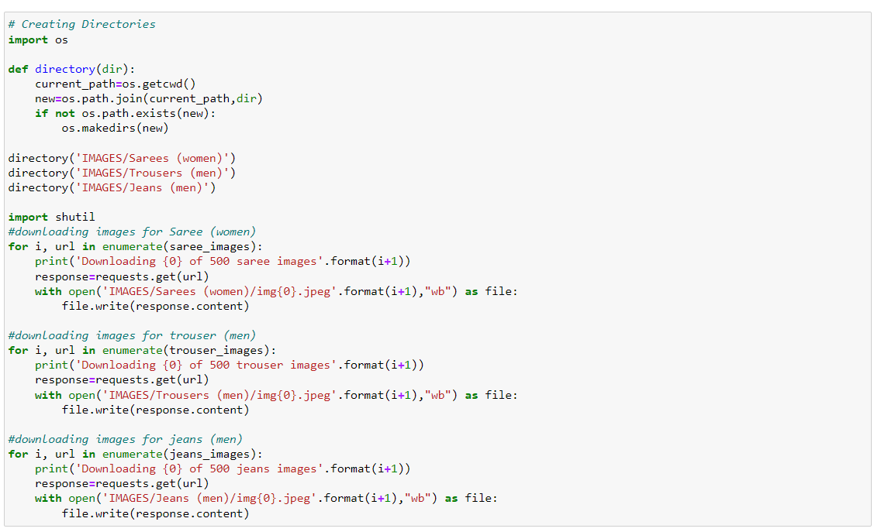
Saving the scraped images

Slide 7
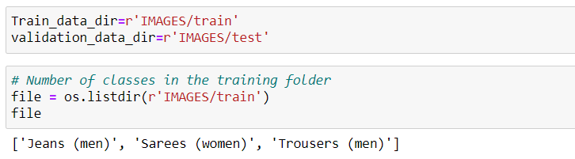
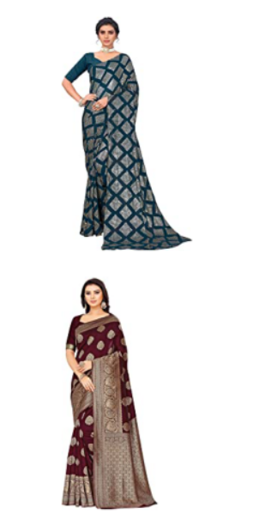
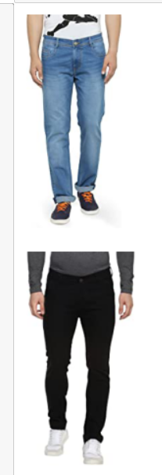
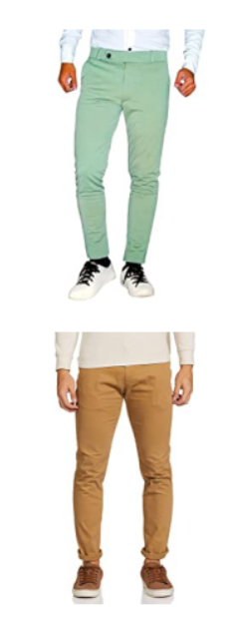
Training the model

Slide 8
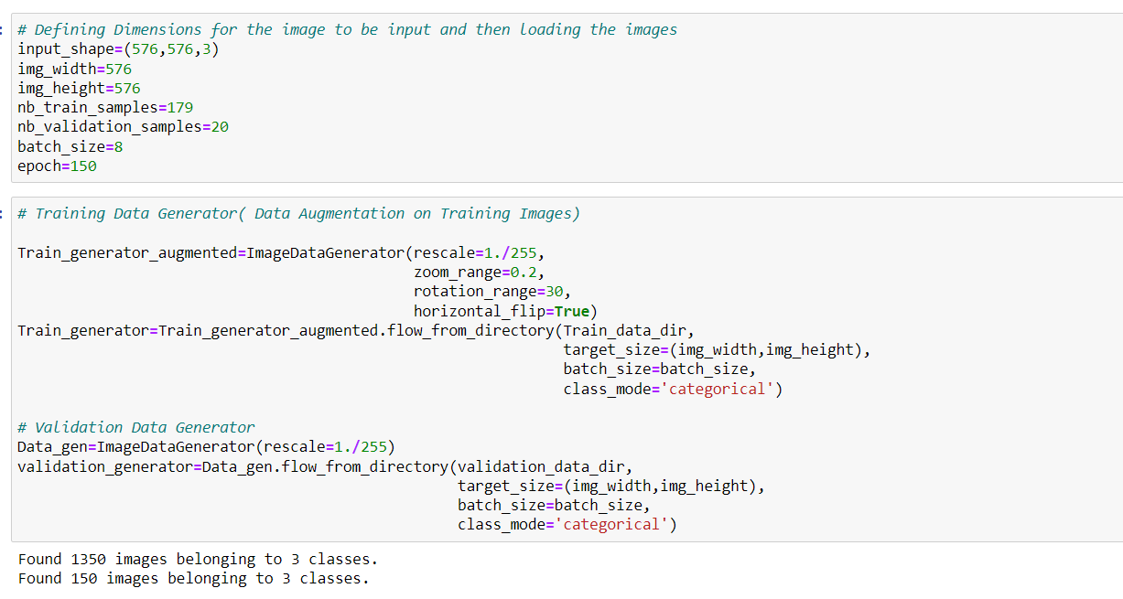
Data augmentation

Slide 9
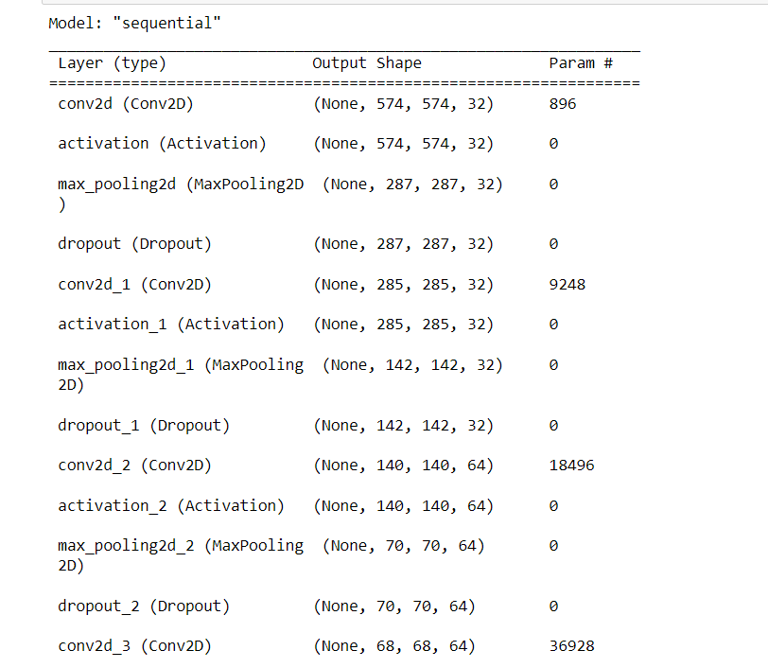
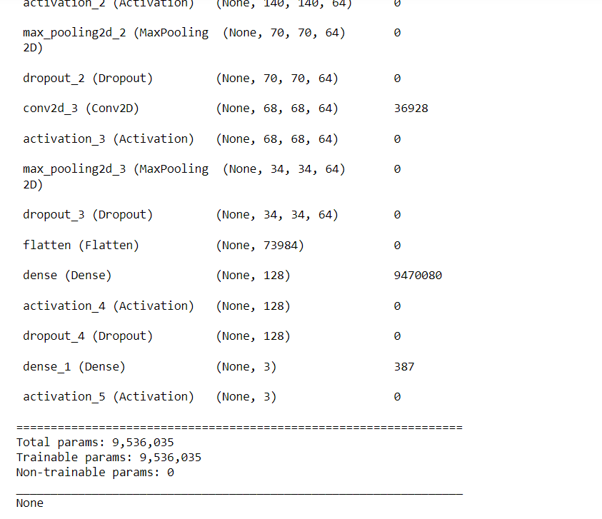
Structure of the layers used for forward and back propagation:

Slide 10
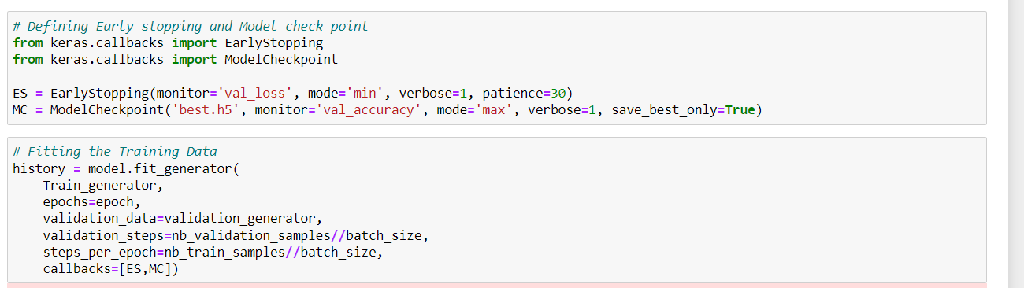
Fitting the model

Slide 11
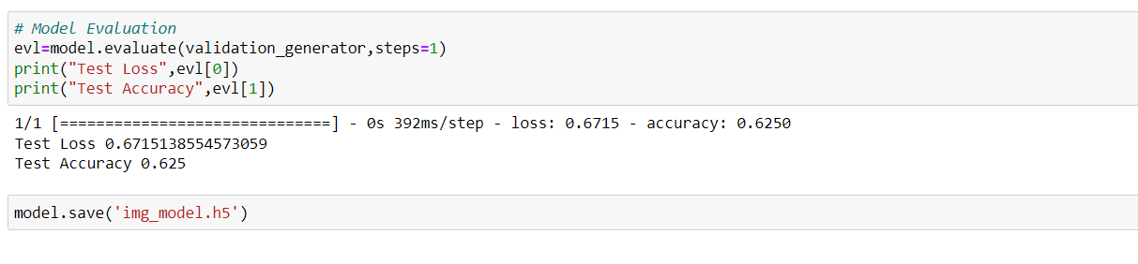
Model evaluation

Slide 12
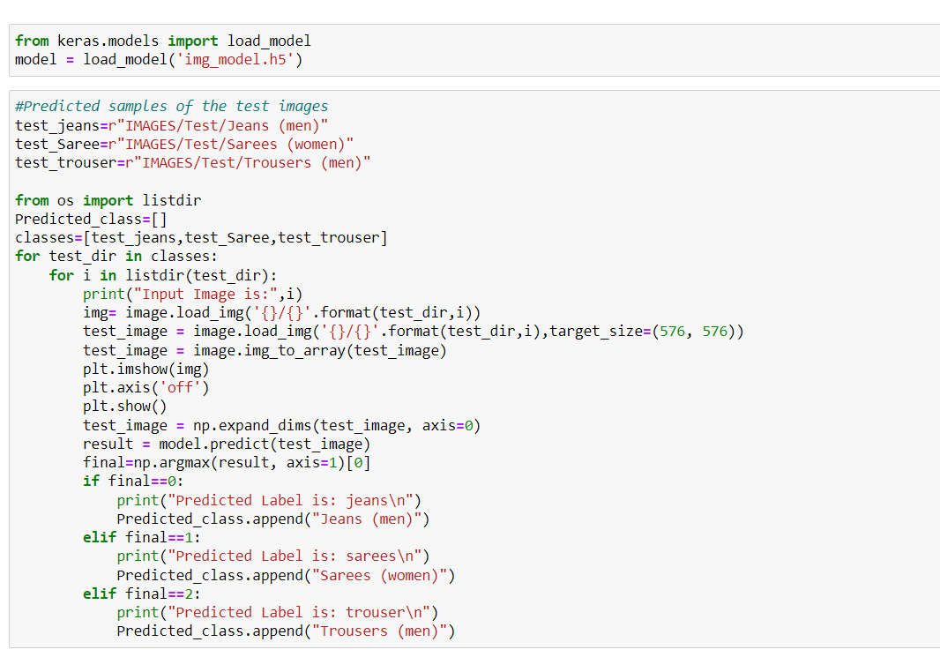
prediction

Slide 13
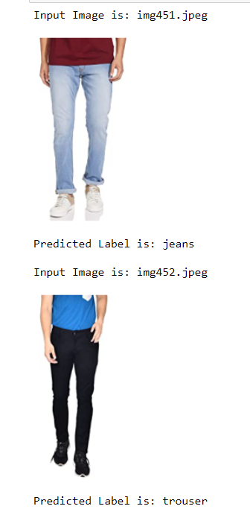
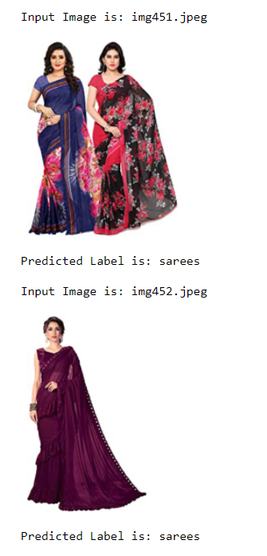
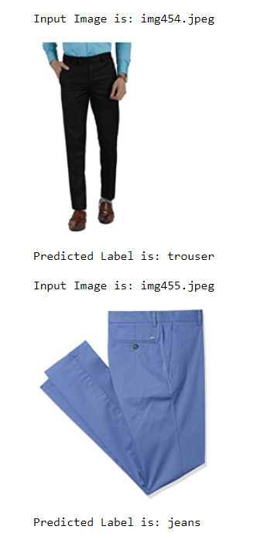
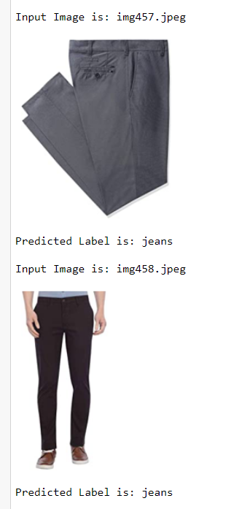

Slide 14
conclusion
Our classification model gives 62.5% accuracy.
The can be enhanced by using more training images. Here, I have used 1500 images for each category which can be increased to 1000-1500 images per category.

